Slide 1


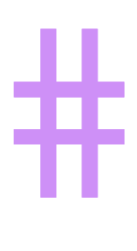



⥫
Creating a Website for a Programmatically Generated NFT Collection
Anoop Reddy Kunta Rohith Matam

Slide 2

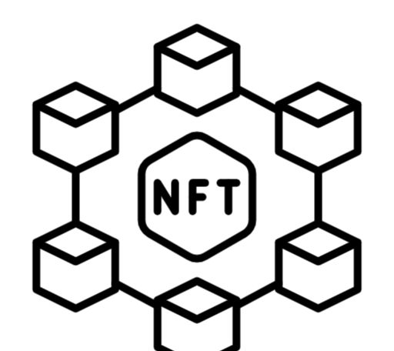



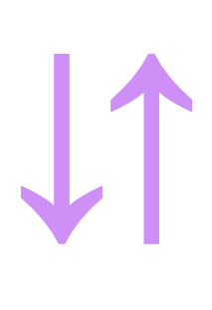
Introduction
Blockchain technology enables decentralization and secure digital transactions
Non-Fungible Tokens (NFTs) have emerged as a novel way to represent unique digital assets
This project aims to explore an efficient method for generating NFT collections and developing a website for NFT transactions using cryptocurrency

Slide 3
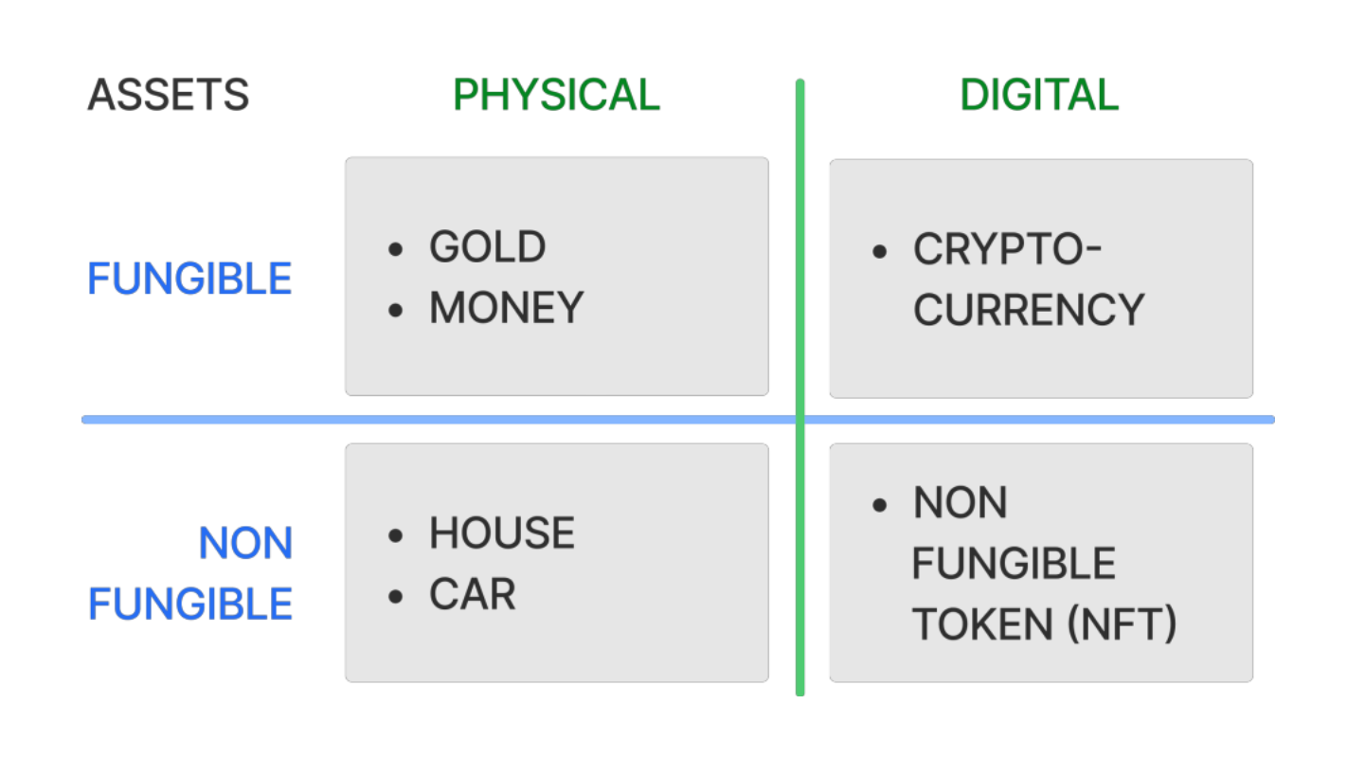


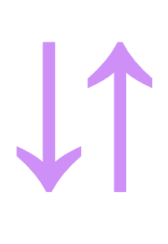
Blockchain Fundamentals
What is Blockchain?
Distributed, decentralized digital ledger that records transactions across many computers
Provides transparency, security, and immutability of data
Fungibility vs. Non-Fungibility
Fungible assets are interchangeable (e.g. cryptocurrencies)
Non-fungible assets are unique and not interchangeable (e.g. NFTs)
Pros and Cons of Blockchain
Advantages
Decentralized, transparent, and secure
Enables new types of digital assets (NFTs)
Disadvantages
Energy-intensive
Regulatory uncertainty

Slide 4
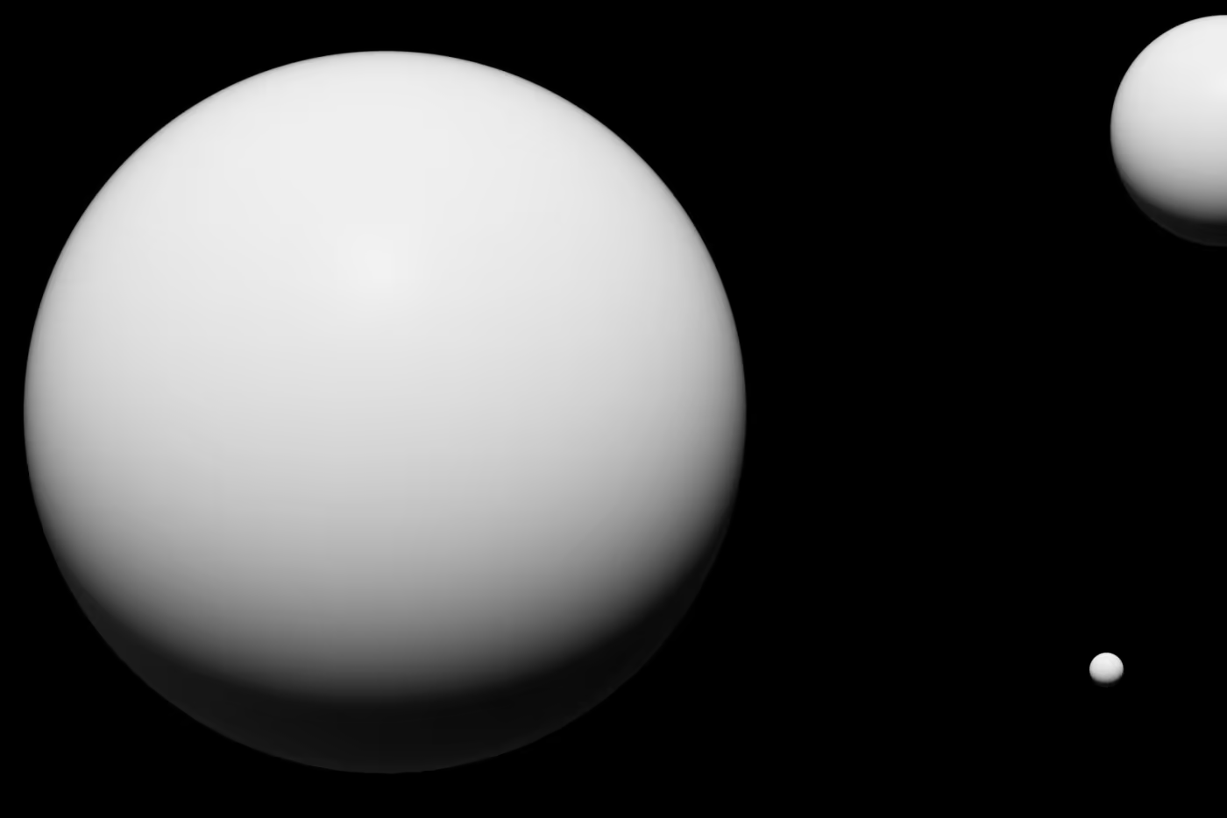





NFTs and the Solana Network
Non-Fungible Tokens (NFTs)
Unique digital assets that cannot be replicated or interchanged
Provide proof of ownership and authenticity for digital items
Solana Network
High-performance blockchain optimized for NFT and DeFi applications
Offers low transaction fees, fast block times, and scalability
Key Advantages of Solana for NFTs
Efficient and cost-effective transactions
Faster processing times compared to other blockchains
Scalability to support large NFT collections and marketplaces
THE MERGE
Notes:
THE MERGE by digital artist pak’s – 91.8 million

Slide 5
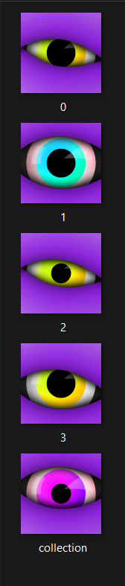
Development Tools and Methods
NFT Creation and Minting Tools
HashLips Art Engine
Procedural NFT generation tool for creating unique artworks. GITHUB LINK - https://github.com/HashLips/hashlips_art_engine
The Candy Machine
No-code tool for minting and deploying Solana-based NFT collections.
Solana CLI
Command-line interface for interacting with the Solana blockchain.
Importance of the Tools
HashLips Art Engine enables efficient and scalable NFT generation.
The Candy Machine simplifies the minting and deployment process.
Solana CLI provides direct access to the blockchain for advanced customization.
These tools work together to streamline the entire NFT creation and minting workflow, making it accessible for both technical and non-technical users.

Slide 6
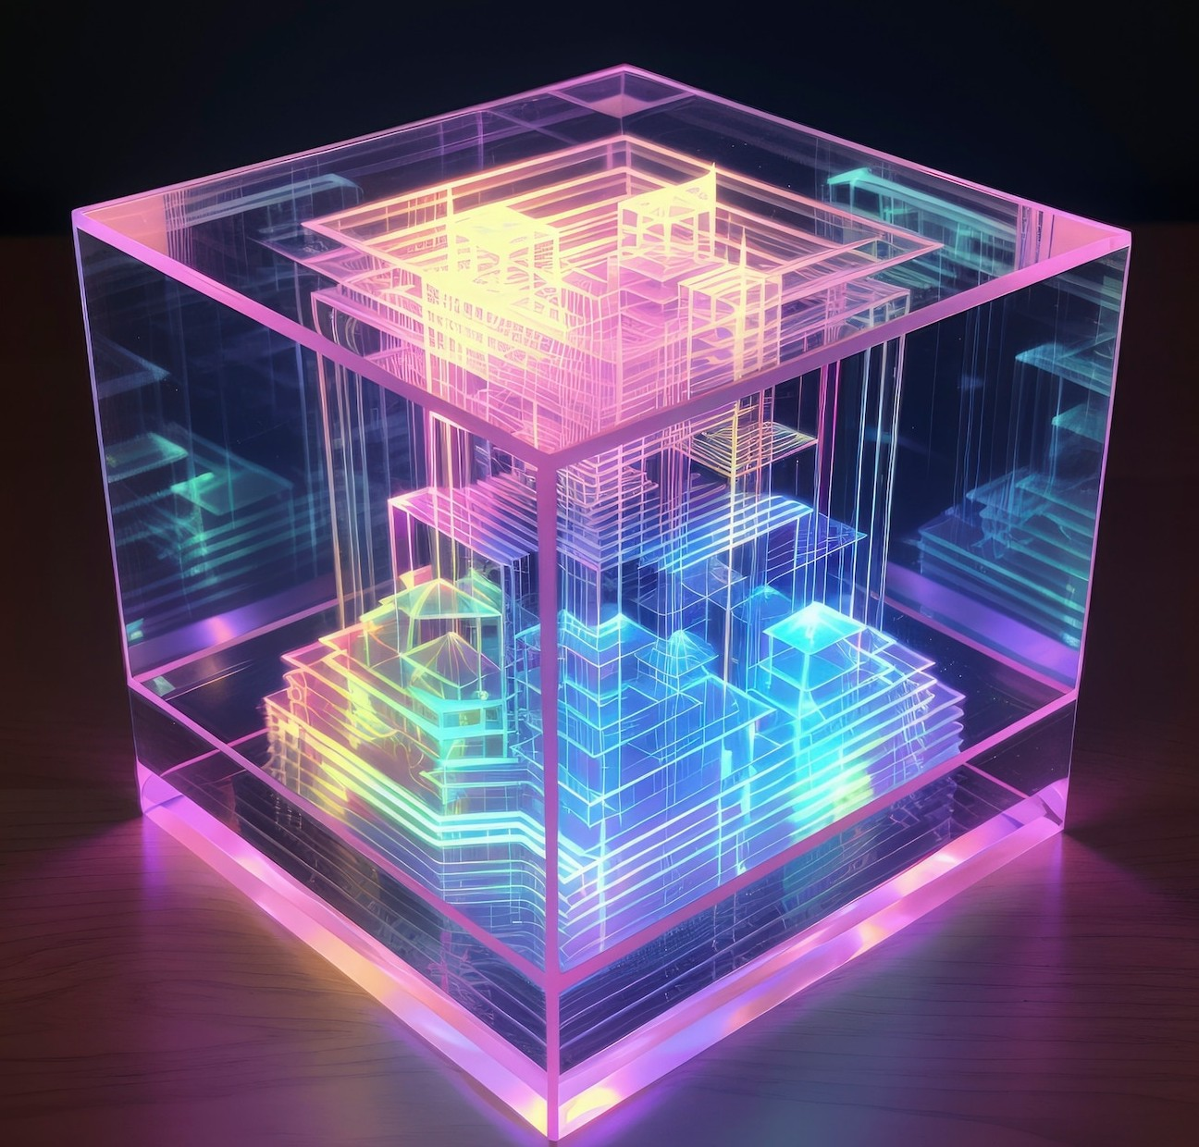




Design and Implementation
NFT Generation and Deployment
Environment Setup
Install necessary software (Node.js, Rust, Solana CLI)
Configure development tools (HashLips Art Engine, The Candy Machine)
NFT Collection Creation
Design and generate unique NFT artworks using HashLips Art Engine
Prepare metadata and assets for the NFT collection
Deployment to Solana Blockchain
Use The Candy Machine to mint and deploy the NFT collection to Arweave
Leverage Solana's blockchain for secure, decentralized storage and transactions
This end-to-end workflow enables the efficient creation and deployment of unique NFT collections on the Solana network, providing a seamless experience for both creators and collectors.

Slide 7


Creating the NFT Website
Key Features
Website development for seamless NFT transactions
Integration of wallet connectivity and minting process
Enabling users to browse, buy, sell, and manage NFTs
Development Process
Utilize web development frameworks (e.g., React, Vue.js) to build the front-end
Integrate blockchain APIs (e.g., Solana Web3.js) for wallet integration and minting
Implement secure payment gateways and transaction handling
Design an intuitive and user-friendly interface for NFT marketplace
Benefits
Streamlined NFT buying and selling experience for users
Improved accessibility and scalability of the NFT platform
Enhanced security and transparency through blockchain integration
The NFT website serves as a centralized hub for users to engage with the NFT ecosystem, leveraging blockchain technology to provide a seamless and secure NFT transaction experience.

Slide 8
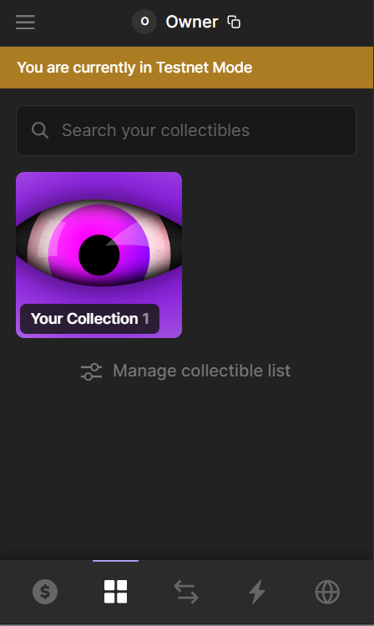
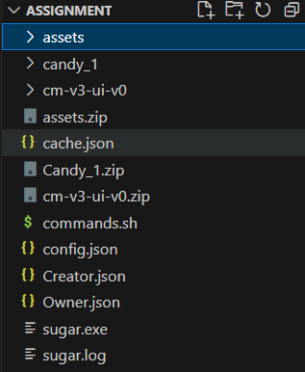
Website Screenshots
1. Phantom Wallet of an Owner with NFT
2. Directory Structure of the website

Slide 9
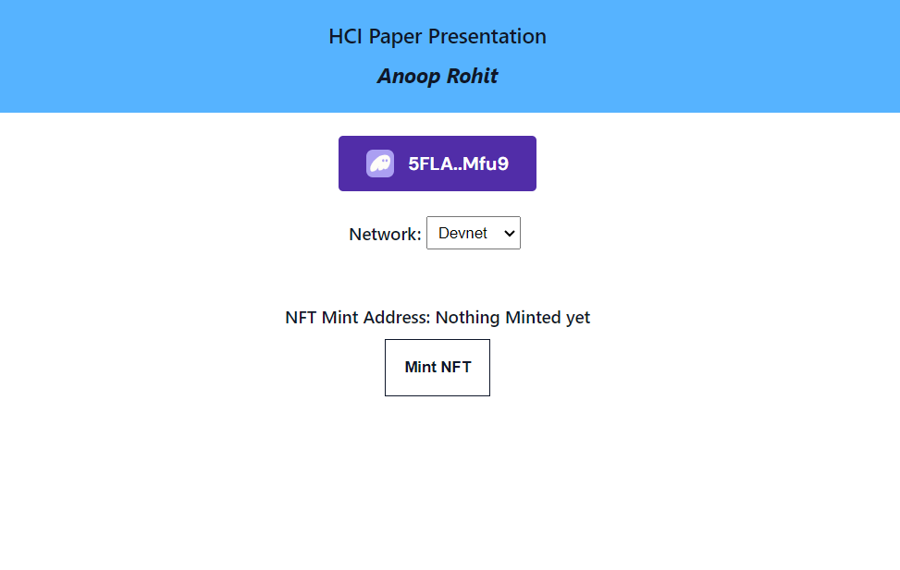
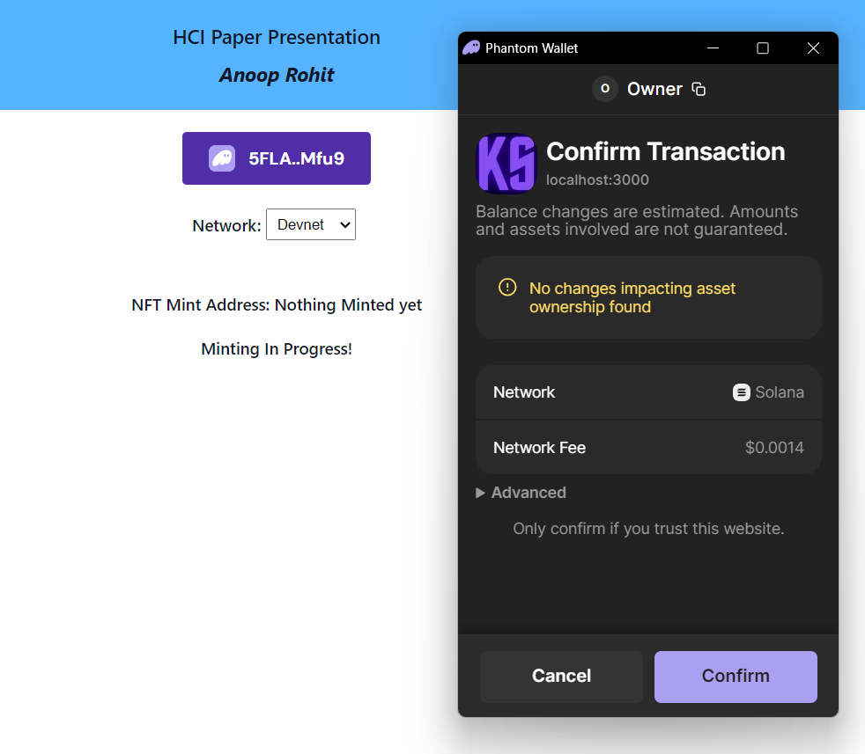
Website Screenshots
3. Candy Machine UI for the NFTs
4. Process for the Minting of NFTs with Phantom Wallet

Slide 10
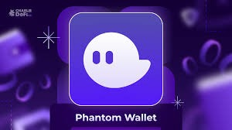





Results and Discussion
Key Observations and Findings
Efficient NFT generation using HashLips Art Engine and The Candy Machine
Seamless integration of wallet connectivity and minting functionality on the website
High demand and user interest in the NFT collection during the minting process
Challenges and Solutions
Challenges
Maintaining performance and scalability during high traffic and minting activities
Ensuring secure and reliable blockchain integration for transactions
Solutions
Optimized infrastructure and server configurations to handle increased demand
Implemented robust security measures and error handling for blockchain interactions
Lessons Learned
Importance of choosing the right tools and technologies for NFT development
Necessity of comprehensive testing and monitoring during the entire project lifecycle
Value of user feedback and continuous improvement to enhance the NFT platform
The project successfully demonstrated the viability of an efficient NFT generation and transaction platform, while also highlighting the importance of addressing technical and operational challenges to deliver a reliable and user-friendly experience.

Slide 11


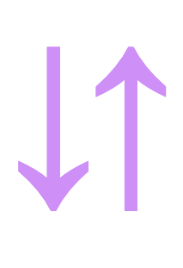
Conclusion and Future Work
Project Achievements
Developed an efficient method for generating unique NFT collections
Designed and implemented a website for seamless NFT transactions using the Solana blockchain
Demonstrated the successful deployment and user adoption of the NFT platform
Future Enhancements
Expand the NFT ecosystem with additional features and functionalities
Implement advanced search, filtering, and recommendation capabilities
Integrate secondary market trading and royalty management
Explore cross-chain compatibility for wider accessibility
Potential Applications
Utilize the NFT platform for various use cases beyond digital art
Tokenize real-world assets (e.g., collectibles, property deeds)
Enable NFT-based loyalty programs and virtual experiences
Integrate the platform with metaverse and gaming environments

Slide 12





References
Nakamoto, S. (2008). Bitcoin: A Peer-to-Peer Electronic Cash System.
Buterin, V. (2014). A Next-Generation Smart Contract and Decentralized Application Platform.
Aloini, D., Dulmin, R., Mininno, V., & Ponticelli, S. (2012). Controlling Software Project Risks – an Empirical Study of Methods used by Experienced Project Managers. Journal of Management and Governance, 16(2), 239–264.
Ravishankar, A., Misra, S., Yang, L. T., & Rodrigues, J. J. (2020). AI-Driven Agile Software Development: Enhancing Project Management and Process Improvement. IEEE Access, 8, 144169-144183.

Slide 13


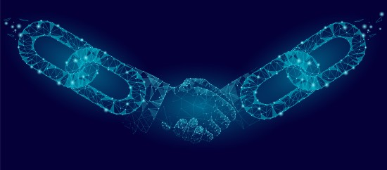









Thanks!

